Slide 1

Geometric Perception and Intelligence Laboratory (Gorilla Lab)
Unsupervised Multi-Class Domain Adaptation: Theory, Algorithms, and Practice
Yabin Zhang*¹², Bin Deng*¹, Hui Tang¹, Lei Zhang², and Kui Jia^{#1}
South China University of Technology¹, The Hong Kong Polytechnic
University & DAMO Academy, Alibaba Group²
*equal contribution, #corresponding author

Slide 2
1
背 景
2
经典的UDA理论、算法回顾
3
提出的多类UDA理论
4
一个多类UDA算法框架
目录
Contents
5
一个新的实现算法
6
实践及其应用

Slide 3
过渡页
背 景
1

Slide 4
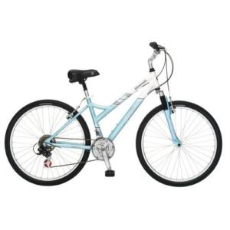
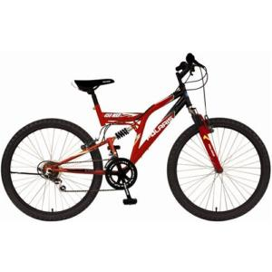
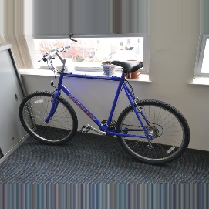
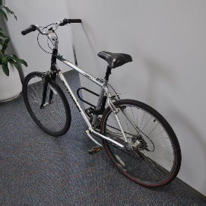
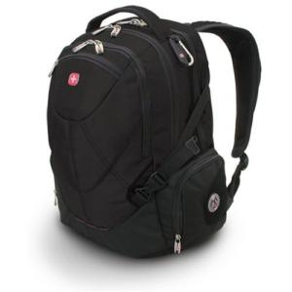
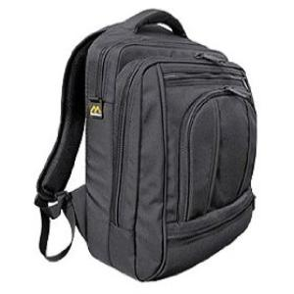
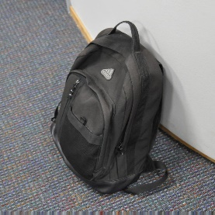

Domain Adaptation
Source Domain
Target Domain
Labeled !
Unlabeled !
Unsupervised Domain
Adaptation (UDA)
Train a model for Target Domain

Slide 5
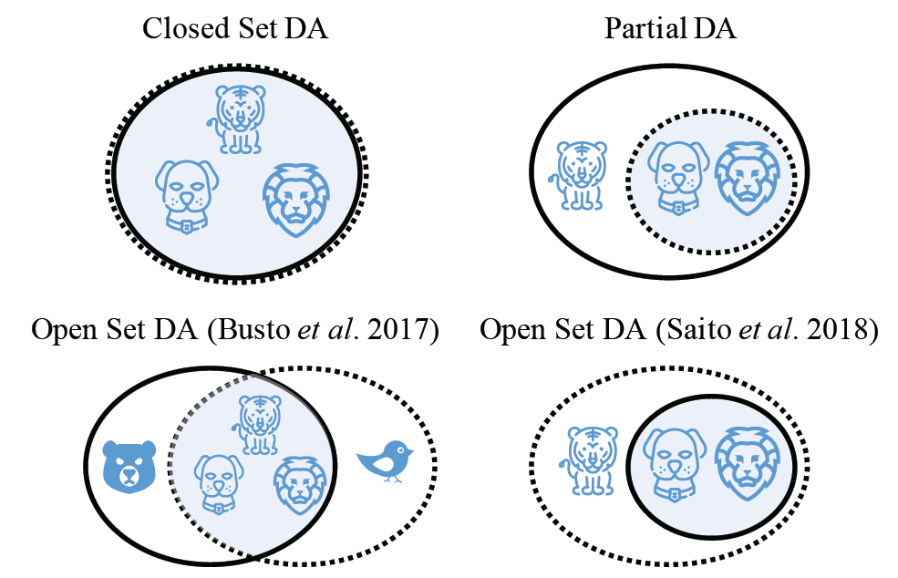
Different Variants of UDA
[You et al., 2019]
Shared label set is known in advance
[1] Pau Panareda Busto and Juergen Gall. Open set domain adaptation. In ICCV, 2017.
[2] Saito, Shohei Yamamoto, Yoshitaka Ushiku, and Tatsuya Harada. Open set domain adaptation by backpropagation. In ECCV, 2018.

Slide 6
过渡页
经典的UDA理论、算法回顾
2

Slide 7
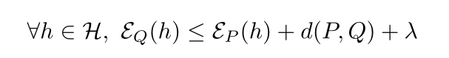
General Theory Scheme
Hypothesis
A constant based on Hypothesis space
Expected error
in source domain
Expected error in target domain
Divergence between source and target domains

Slide 8
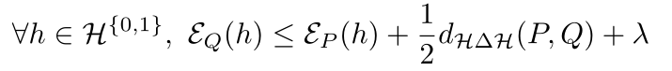
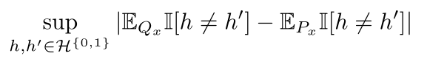
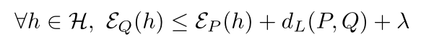
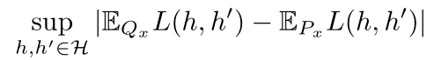
Binary Scenarios
[Ben et al., 2010]
Hypothesis Disagreement (HD)
[Mansour et al., 2009]

Slide 9
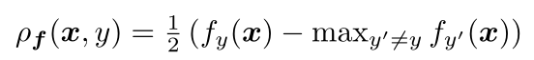
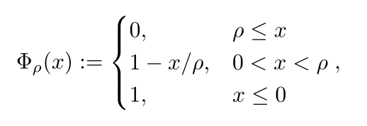
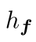
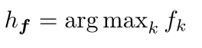
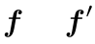
Multi-class Scenario
[Zhang et al., 2019a]
Margin Disparity (MD)

Slide 10
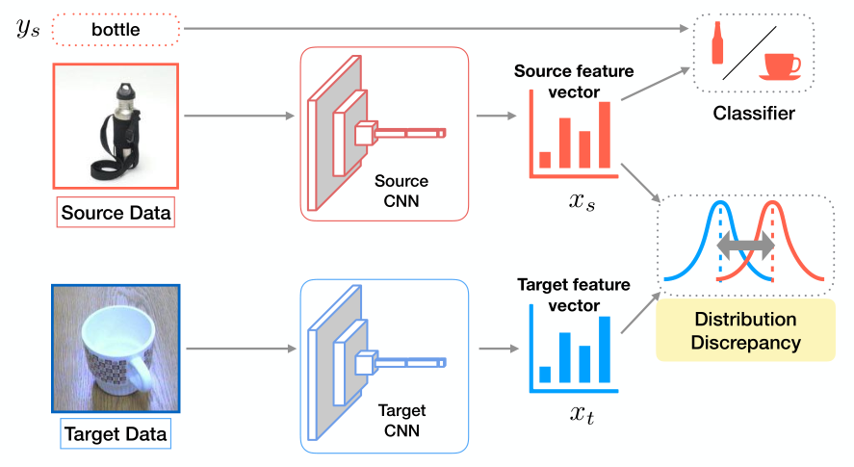
General Algorithm Framework

Slide 11
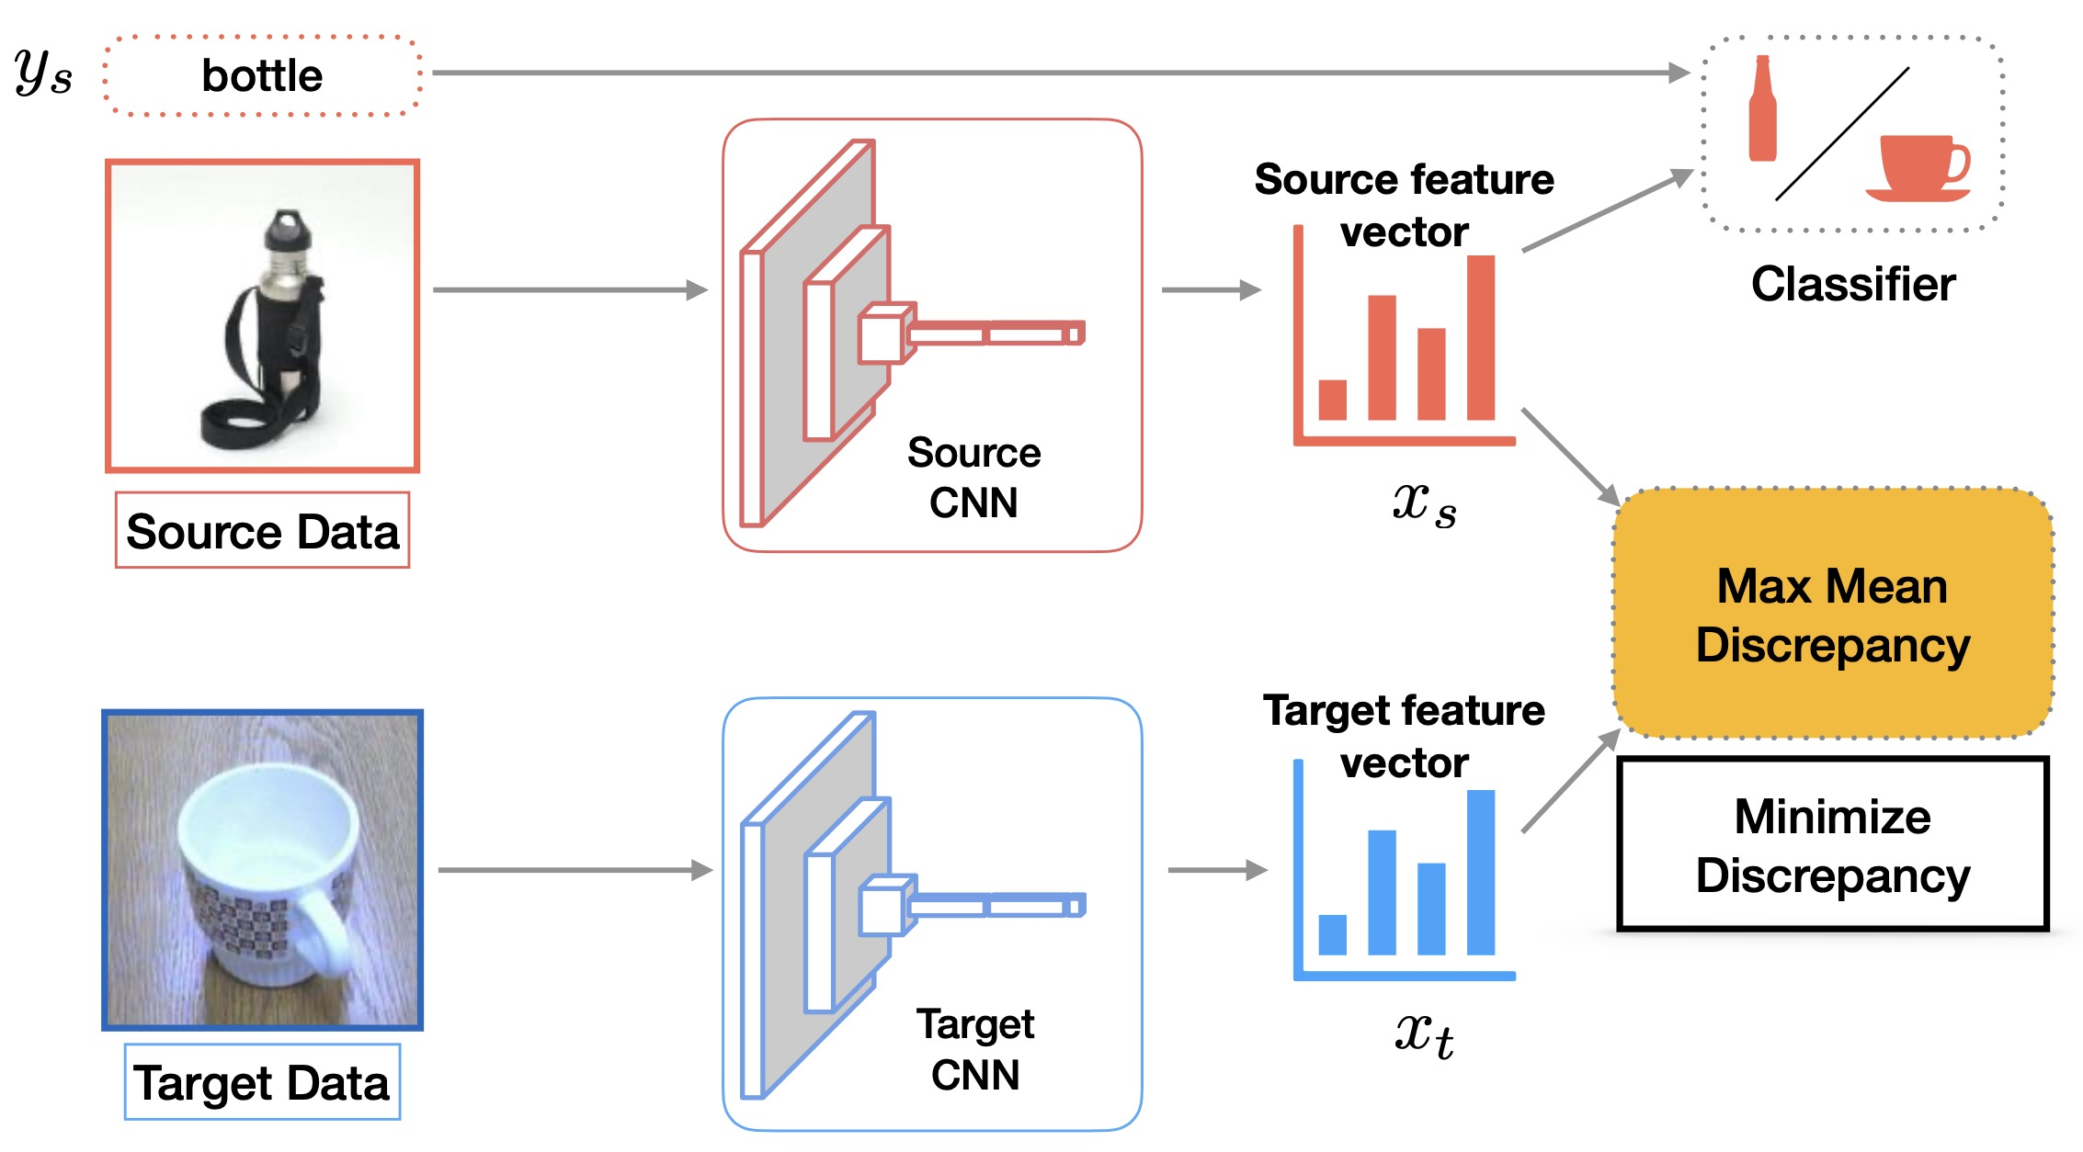
Maximum Mean Discrepancy
[Long et al., 2015]
DAN

Slide 12
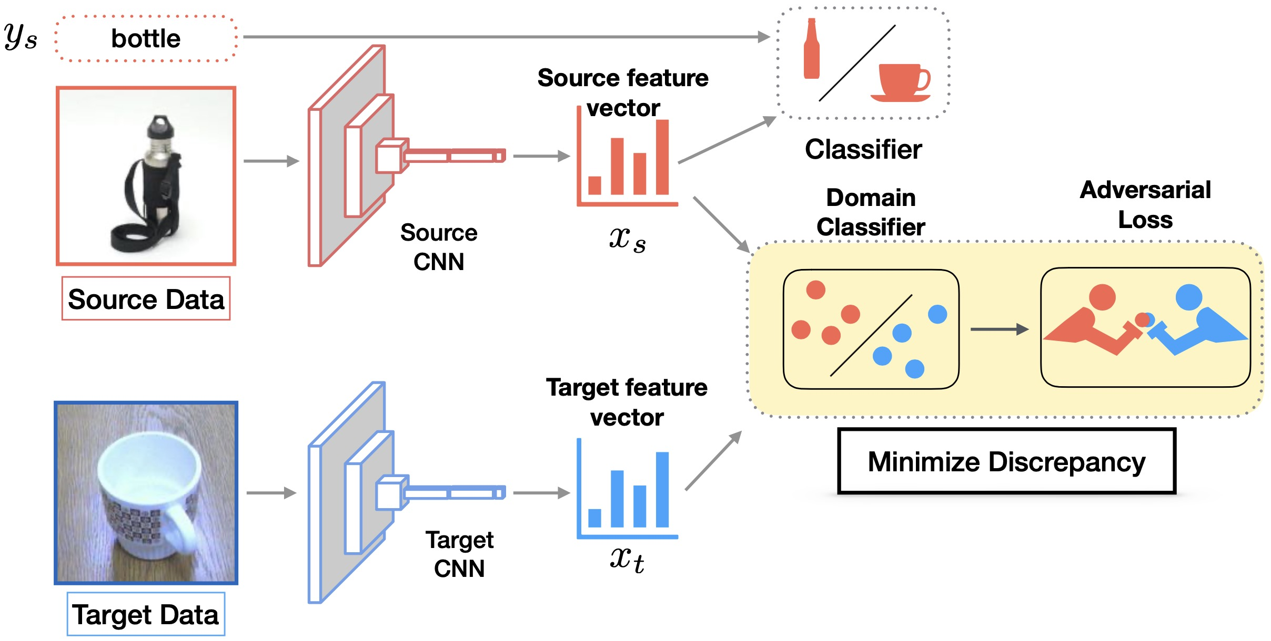
Domain Adversarial Training
[Ganin et al., 2015]
DANN

Slide 13
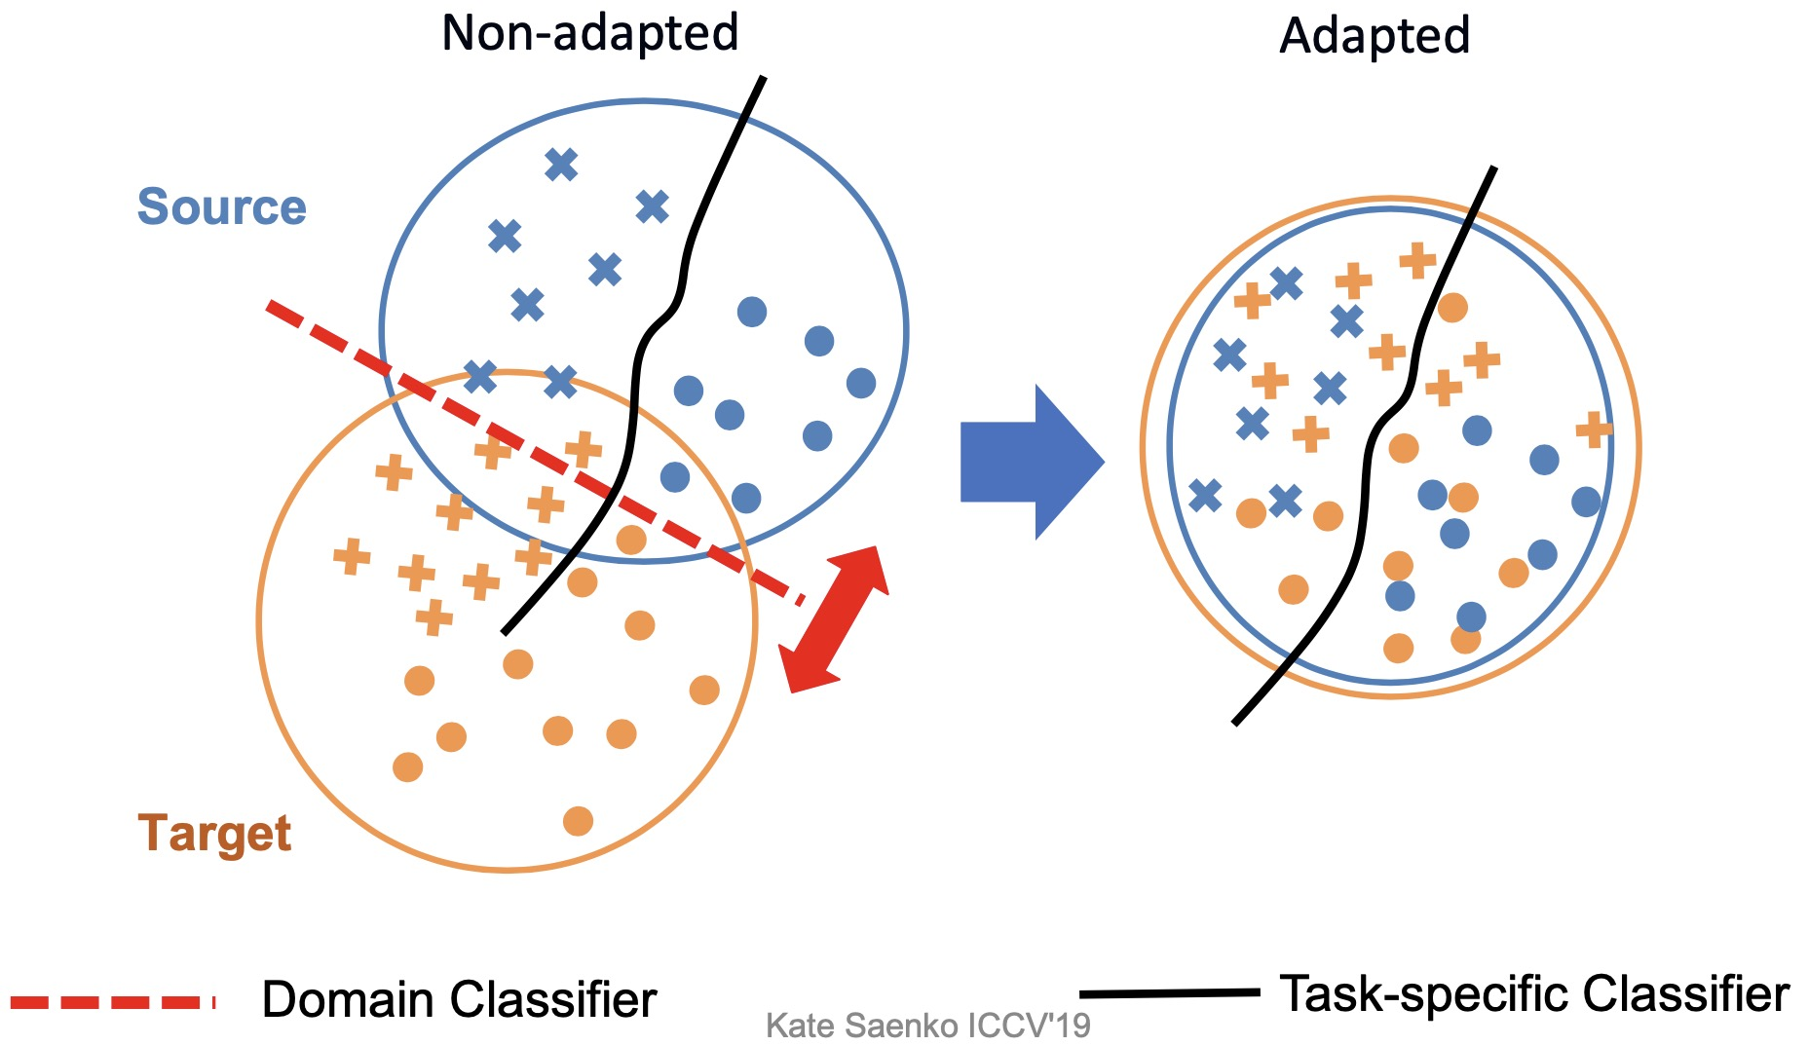
Problem of alignment by using binary domain classifier

Slide 14
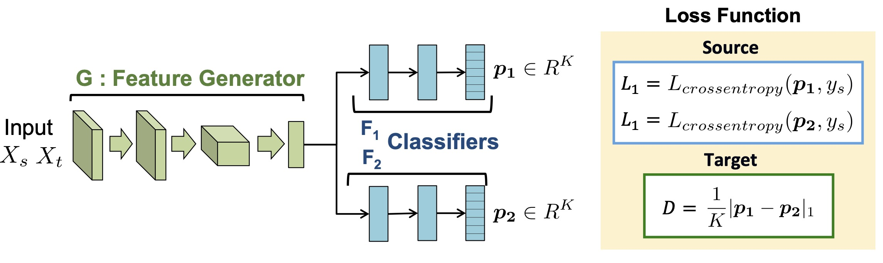
Maximum Classifier Discrepancy
[Saito et al., 2018]
MCD

Slide 15
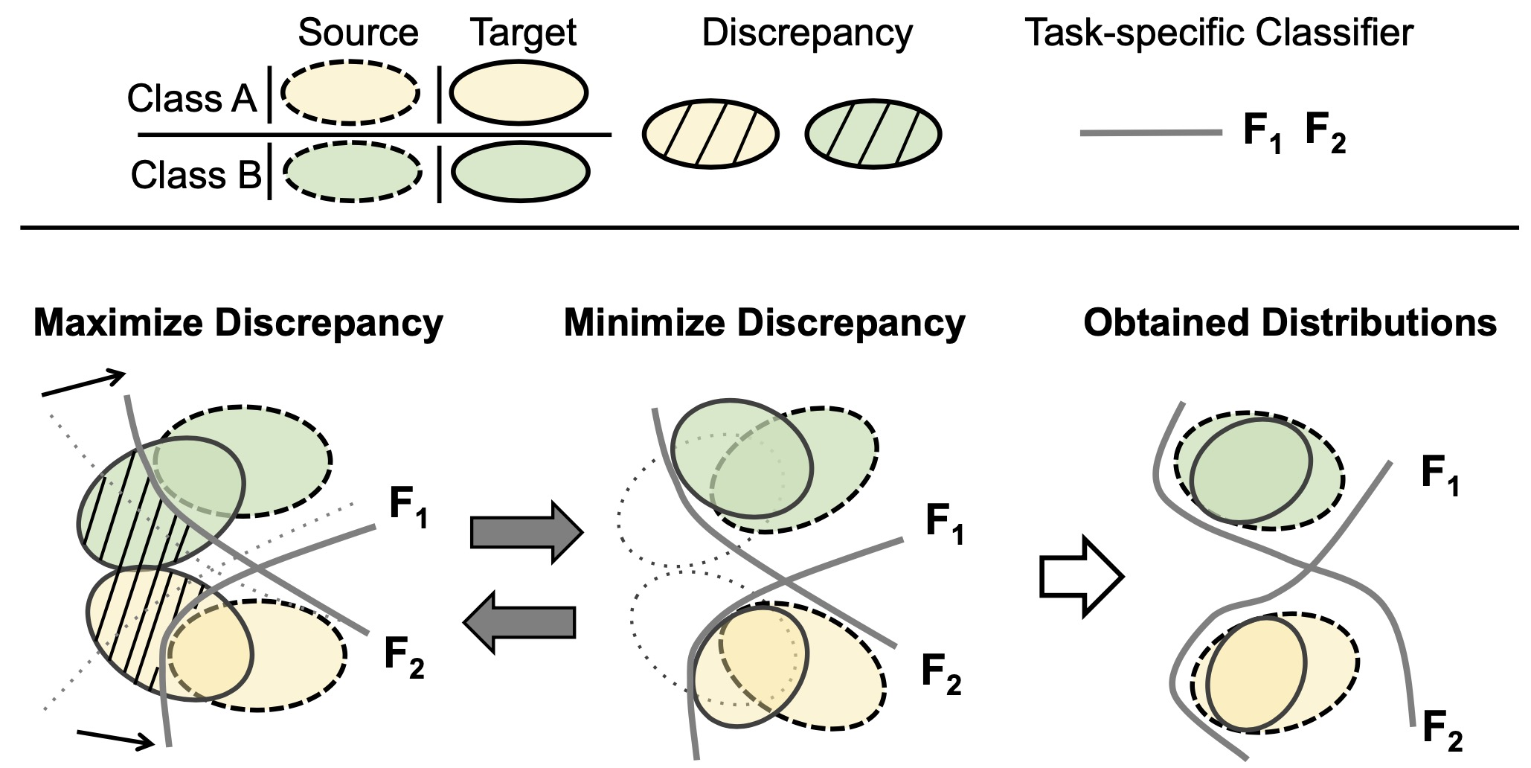
Maximum Classifier Discrepancy
MCD

Slide 16
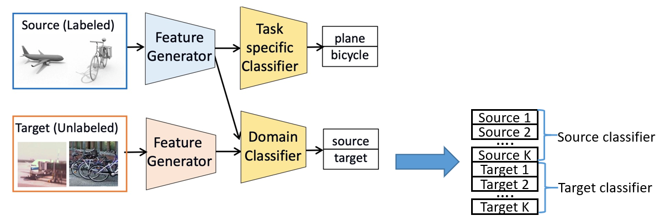
Distribution matching using K-scores alignment
Maximum Classifier Discrepancy [Saito et al., CVPR 2018]
Adversarial Dropout Regularization [Saito et al., ICLR 2018]
Domain Symmetric Networks [Zhang et al., CVPR 2019]
Sliced Wasserstein Discrepancy [Lee et al., CVPR 2019]
…

Slide 17
2
经典的DA理论建立在二元分类的基础上，而现实的算法往往是多类的。
1
1
3
存在的经典算法证明了使用多元对齐进行特征匹配要优于二元判别的分类器匹配。
2
4
3
存在的多类DA理论无法阐明这些基于多元对齐(两个分类器对齐)的有效性。
How to connect these algorithms with a unified theory
4
如何更好地去解释使用多元对齐去匹配特征分布的方案及其优势呢？

Slide 18
过渡页
3
提出的多类UDA理论

Slide 19
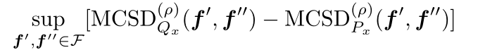
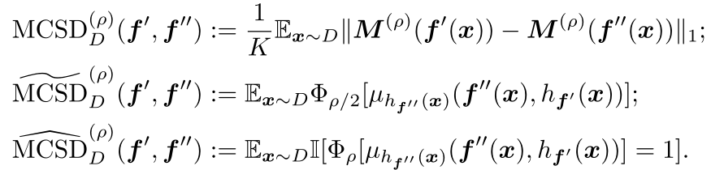
A unified theory based on absolute margin function
多类别得分差异
MD 变种，Zhang et al.
HD 在多类情况下的形式, Ben et al.

Slide 20
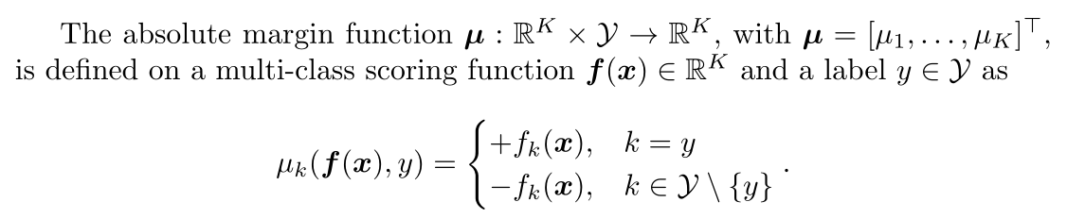
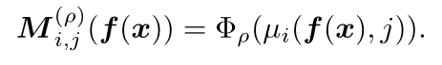
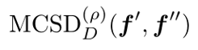
Absolute Margin Function
[Dogan et al., 2016]

Slide 21
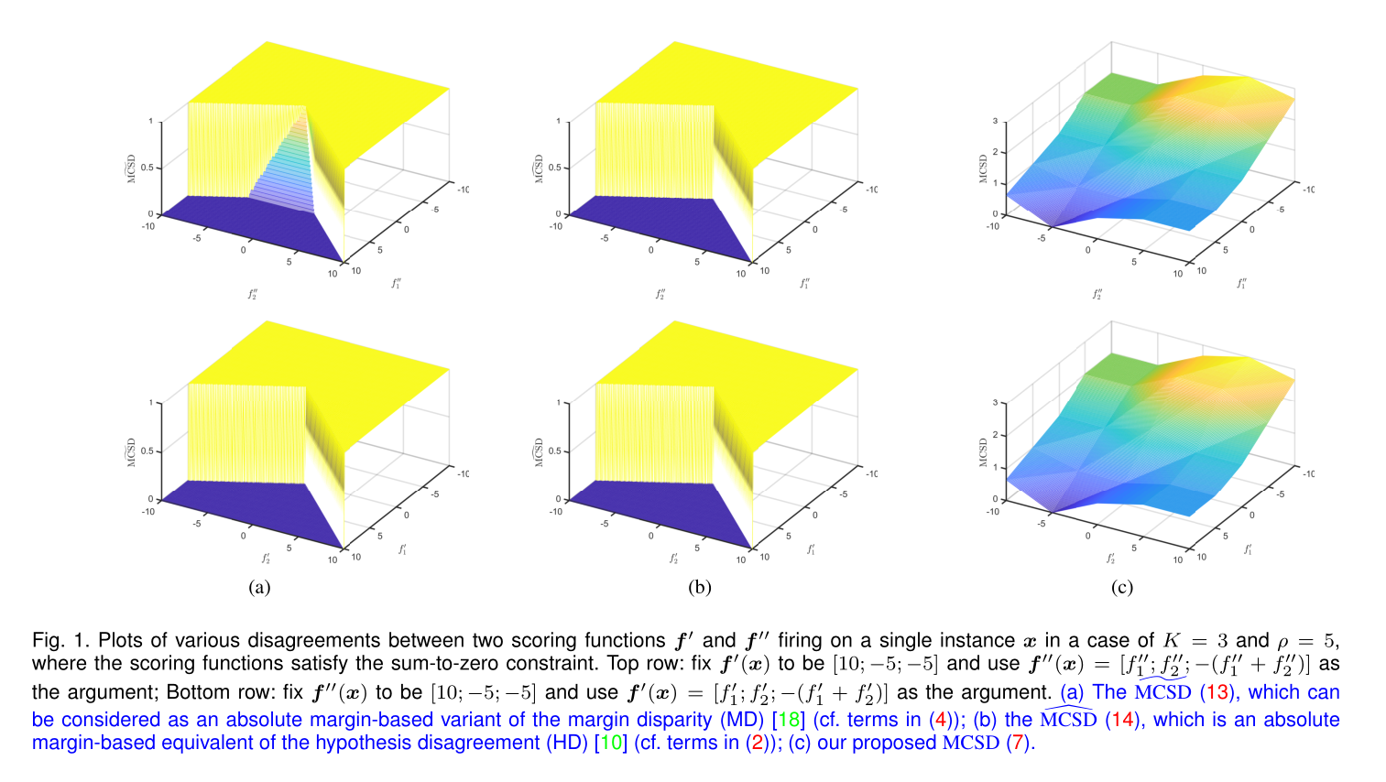

Slide 22
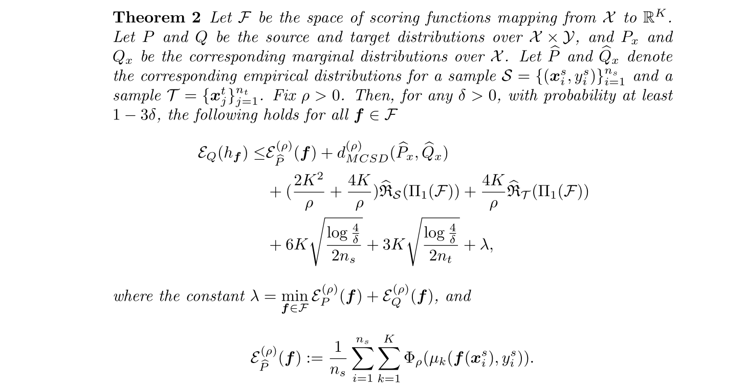
Our Main Result

Slide 23
过渡页
4
一个多类UDA算法框架

Slide 24
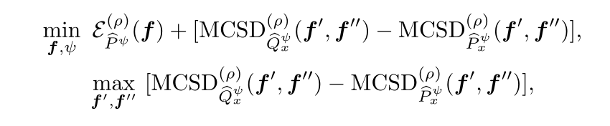
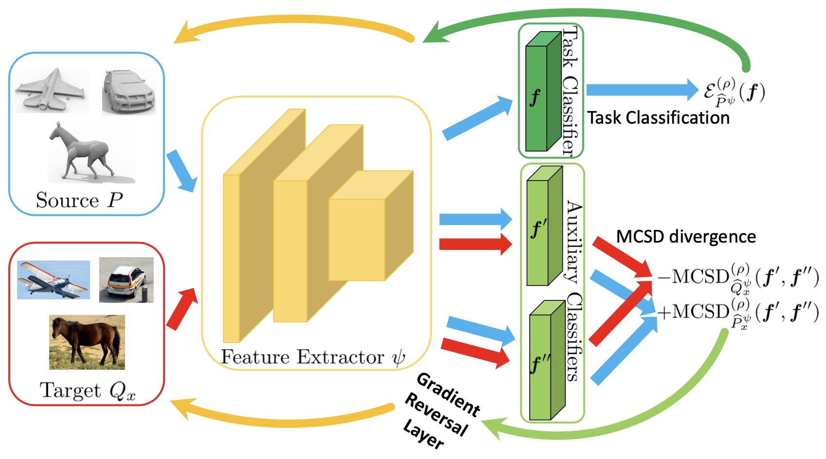

Slide 25
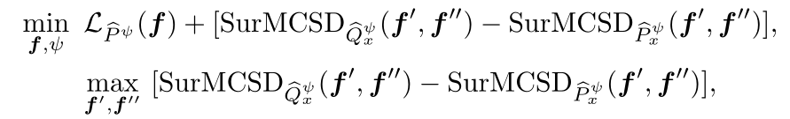
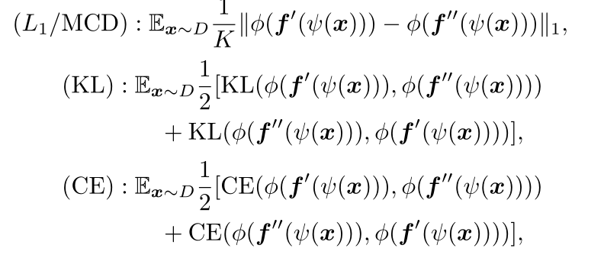
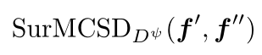
Implement by surrogate objectives

Slide 26
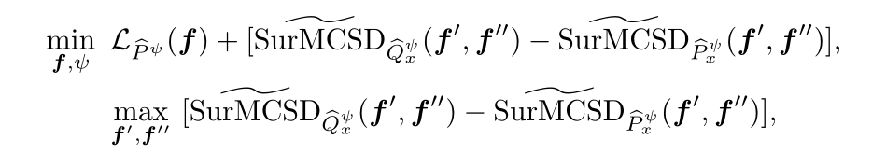
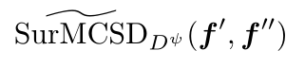
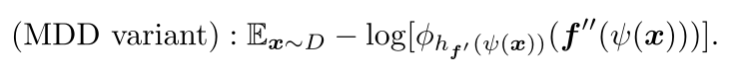
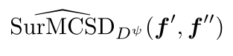

Implement by surrogate objectives

Slide 27
过渡页
5
一个新的实现算法

Slide 28
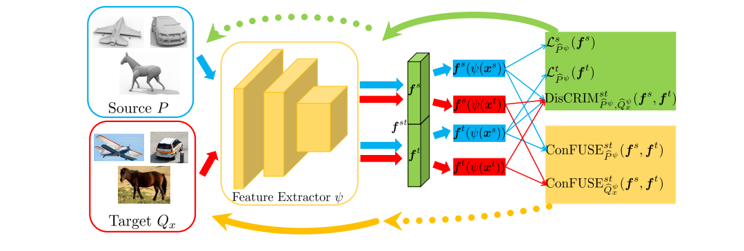
SymmNets-V2

Slide 29
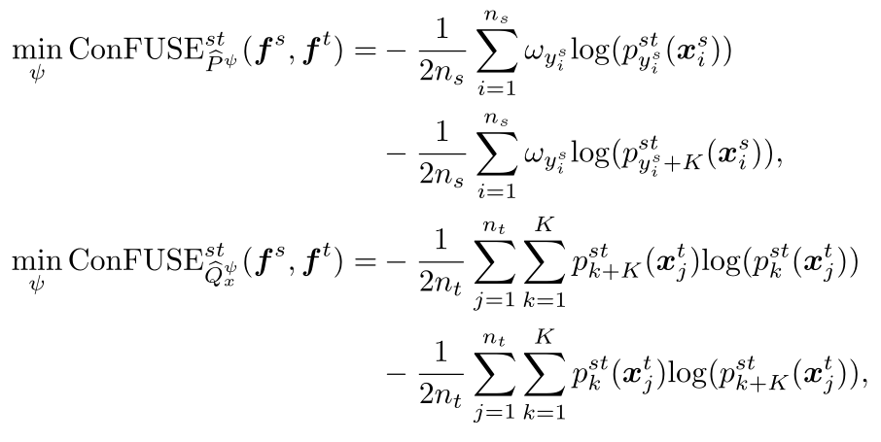
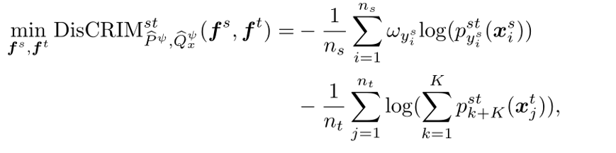

Slide 30
过渡页
实践及其应用
5

Slide 31
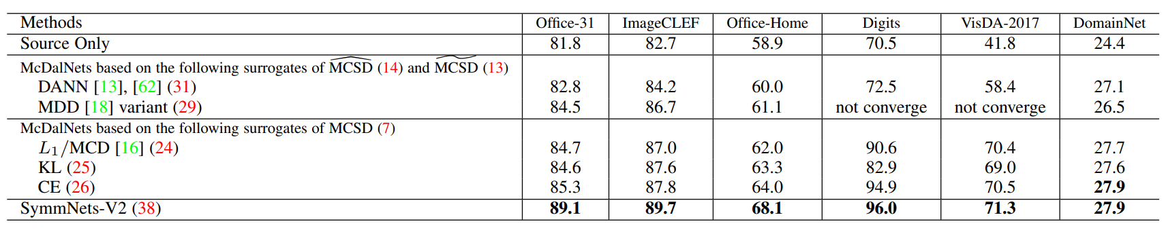
Empirical Results

Slide 32
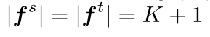
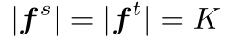
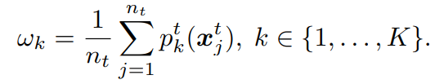
Extend to partial and open set DA
unknow
open set
partial set
Introducing category weight to the source examples

Slide 33
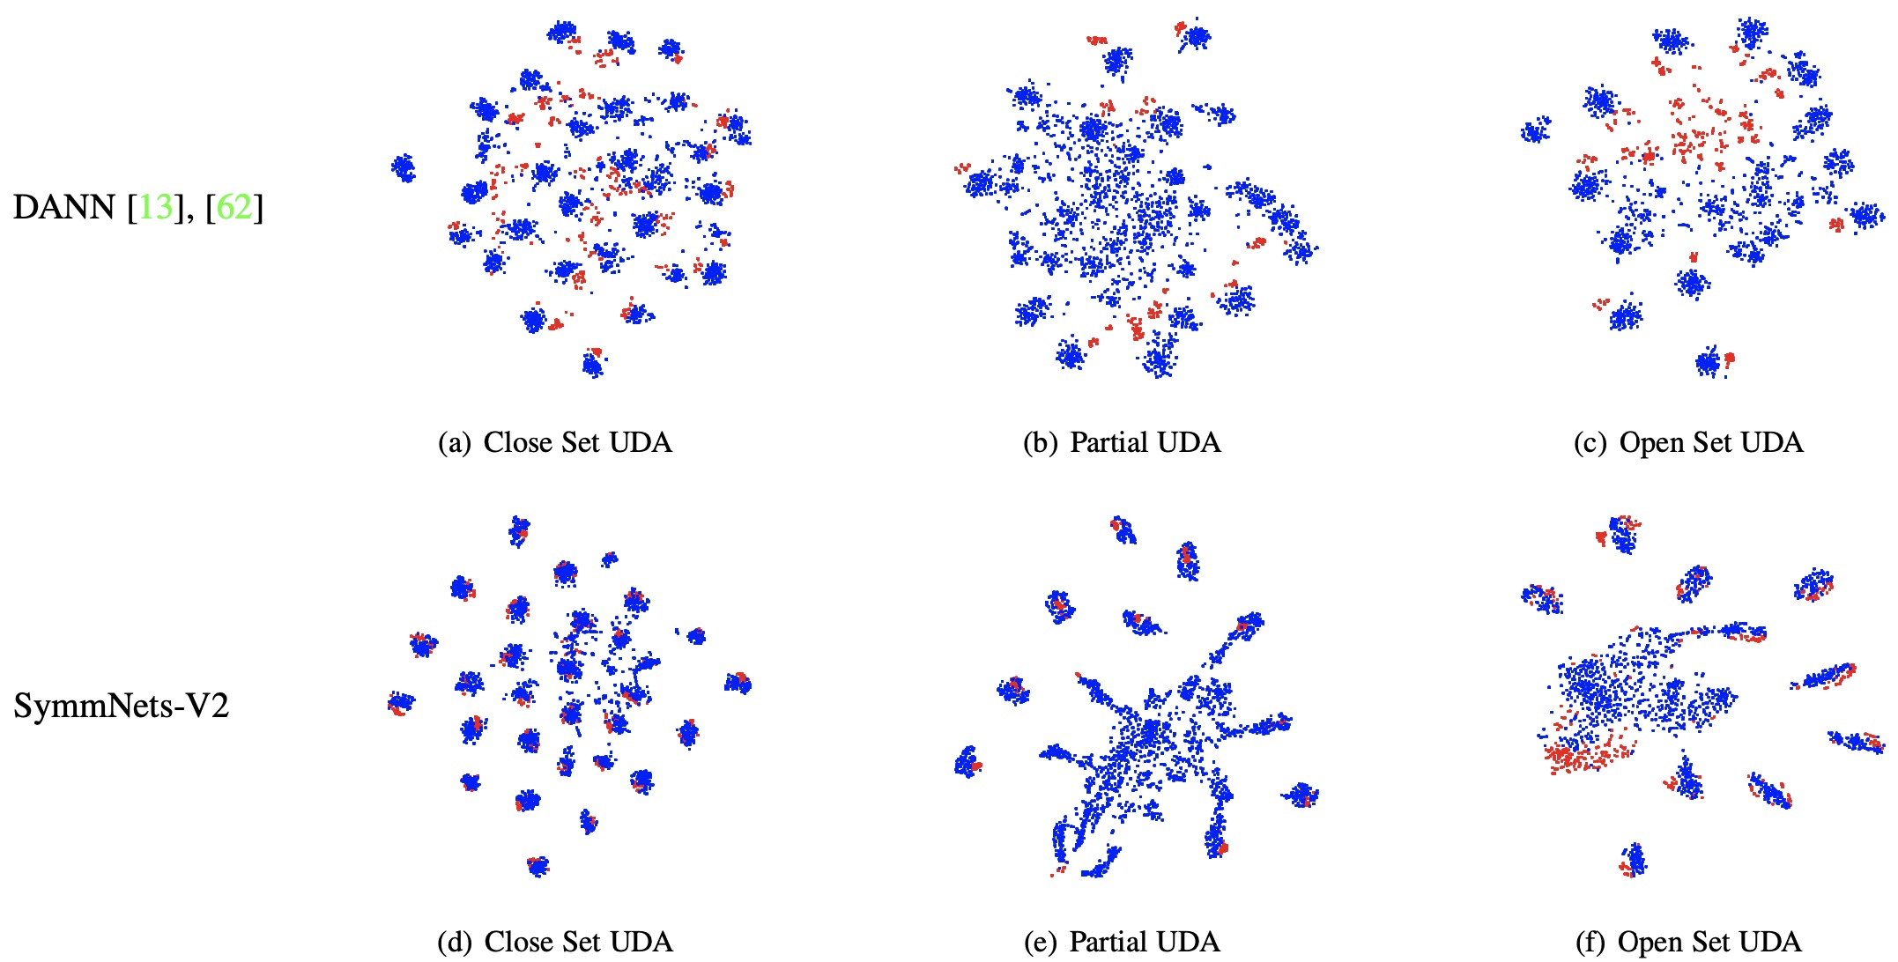
Empirical Results

Slide 34
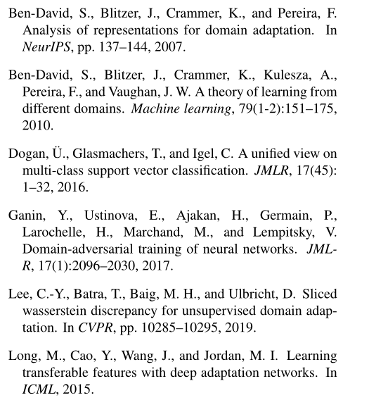

References

Slide 35
Geometric Perception and Intelligence Laboratory (Gorilla Lab)
Thanks & Questions?
Yabin Zhang*¹², Bin Deng*¹, Hui Tang¹, Lei Zhang², and Kui Jia^{#1}
South China University of Technology¹, The Hong Kong Polytechnic
University & DAMO Academy, Alibaba Group²
*equal contribution, #corresponding author

